Slide 1
Children & Youth Program
Anne Hamilton, Team Lead
Elaina Roberts, Grant Management Specialist
New Grantee Orientation December 10-12, 2024

Slide 2
Meet the OVW CYEM Team
Krista Blakeney-Mitchell, Associate Director
Anne Hamilton, Team Lead
Elaina Roberts, Grant Management Specialist
Derek O’Leary, Grant Management Specialist
Traci Rollins, Grant Management Specialist
Sheila Griese, Program Analyst
Catherine Godwin, Grants Management Analyst

Slide 3
Activity
Find a common element among everyone at your table and create a slogan or tag line for your table around that element.
The element can be anything! Favorite food, color, activity, where you are from, places you have visited, books you have read . . . The list goes on!
Be prepared to report out on your slogan!

Slide 4
Session Overview
Grant Award Basics
Managing Your Award
CY Purpose Areas and OVW Priority Areas
Grant Administration
Notes:
Grant Award Basics – length of the award, where we’re currently at, different stages of the project; know where to find information about your award.
Managing Your Award – briefly touch on using the Justice Grants System; Entity Admin and Roles in JGS
CY Purpose Areas and OVW Priority Areas – program requirements and unallowable activities
Grant Administration – monitoring and compliance touch points.

Slide 5
Session Goals
Identify the different stages of the grant project and associated resources.
Understand program requirements for your purpose area as well as the unallowable program activities.
Determine when to submit a project deliverable or Grant Award Modification (GAM).

Slide 6
Grant Award Basics

Slide 7
General Award Information
Award Project Period: October 1, 2024 – September 30, 2027
Pending Budget Approval: Limited access of $10,000 for OVW TTA
Approved Budget: Access to $50,000 for planning phase
Completion of Planning Phase: Release of funds for implementation

Slide 8
Grant Phases
Pending Budget Approval
Only activities related to OVW required trainings
No grant activities except participation in the NGO
Planning Phase (3 – 4 months)
Meet with OVW and Technical Assistance providers
Submit policies (your organization and project partners)
Submit work plan
Implementation
Begin project activities
Continue activities and maintain communication with OVW and project partners

Slide 9
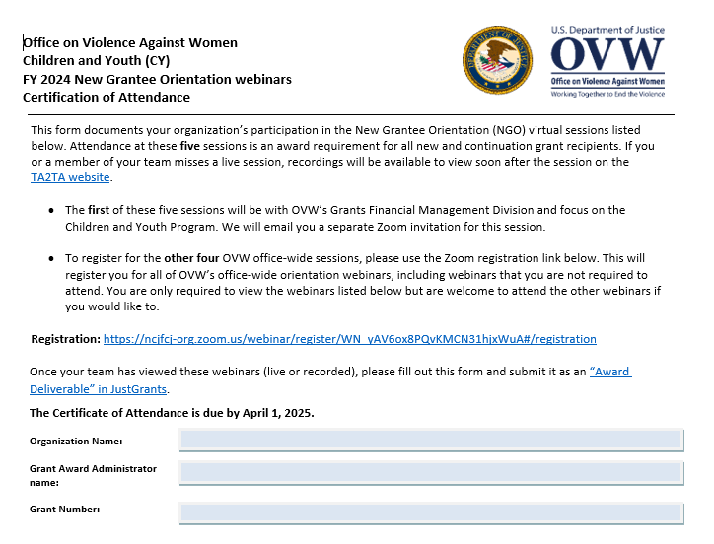
Required Virtual NGO Sessions
OVW Grants Financial Management Division overview: November 13, 2024, 11:30 – 1:30pm ET
Overview of Grant Fraud Investigations: January 15, 2025, 2:00-3:30pm ET
TA2TA: The TA Provider Resource Center: January 16, 2025, 2:00-3:00pm ET
Civil Rights Obligations of Federal Recipients of Financial Assistance: January 27, 2025, 2:00 to 3:30pm ET
Overview of Grant Award Audits: January 28, 2025, 2:00 to 3:30pm ET
Recordings will be posted on TA2TA.org.

Slide 10
Award Condition 56:
Conditional Clearance with Technical Assistance Funds
The recipient acknowledges that the budget for this award is pending review and approval. Until OVW approves the budget, any obligations or expenditures incurred by the recipient are made at the recipient's own risk. The recipient may obligate, expend, or draw down up to $10,000 for participation in or travel-related expenses to attend OVW-sponsored technical assistance events, but these obligations and expenditures remain at the recipient's own risk until the budget is approved. Remaining funds will not be available for drawdown until OVW's Grants Financial Management Division has approved the budget and budget narrative via a Grant Award Modification (GAM). If applicable, the Indirect Cost Rate will be identified in the GAM when the budget is approved. If there is another condition on the award prohibiting any obligation, expenditure, and drawdown of any funds, that other condition will control.

Slide 11
The Planning Phase
An opportunity at the beginning of your grant for the project lead and project partner(s) to collaboratively prepare to implement your project.
OVW and the THRIVE TA team will provide direct support throughout this process.

Slide 12
Award Condition 49:
Funding Limits During Planning Phase
The recipient agrees that grant funding during the planning phase is limited to $50,000 and includes the following planning activities: participate in planning meetings with OVW and the Training and Technical Assistance point of contact, develop project partnerships and a coordinated community response team, refine the project focus and increase capacity to implement the project, and hire project staff, if necessary. The recipient agrees to expend, obligate, or draw down only what is necessary to complete the activities for the planning phase. Any funds for implementation of grant activities cannot be expended, obligated, or drawn down until the recipient completes the planning phase, including submission and OVW approval of policies as described in the Submission of policies condition on this award.

Slide 13
Allowable Planning Phase Activities
Development of project partnership and coordinated community response;
Refining project focus and increasing capacity to implement;
Hiring project staff;
Developing project lead’s and required partner’s policies;
You may only begin implementation after approval of planning phase activities.
Notes:
Project activities are unallowable during the planning phase with the exception of continuation grantees. For example, providing support training to parents on healthy relationships for teens – you cannot engage in the creation of the training nor conduct the actual training. We should not see any type of project activity in the performance report until you have completed the planning phase. Another example, providing direct victim services – you cannot bill to this grant for this activity unless you are a continuation grantee that had started these services under the previous award. We do not want there to be a gap in services for victims.

Slide 14
Required Policies
All grant recipients and their required partner must develop, enhance, or revise policies related to confidentiality, information sharing, parental consent, mandatory reporting, and background checks. Two options:
Submit separate written policies for both the lead organization and project partner; or
Submit one set of policies that both organizations agree to follow for purposes of the project.

Slide 15
Development of the Work Plan
All grant recipients and their required partner must collaboratively develop and submit a work plan.
Your work plan encapsulates key information about your grant project. This includes the goals for the project and specific activities that you will implement.
During your planning phase meetings, OVW and the Thrive TA team will provide the template and guidance for completing the work plan.
After your planning phase wrap-up meeting, please submit the completed work plan as an “award deliverable” in JustGrants.

Slide 16
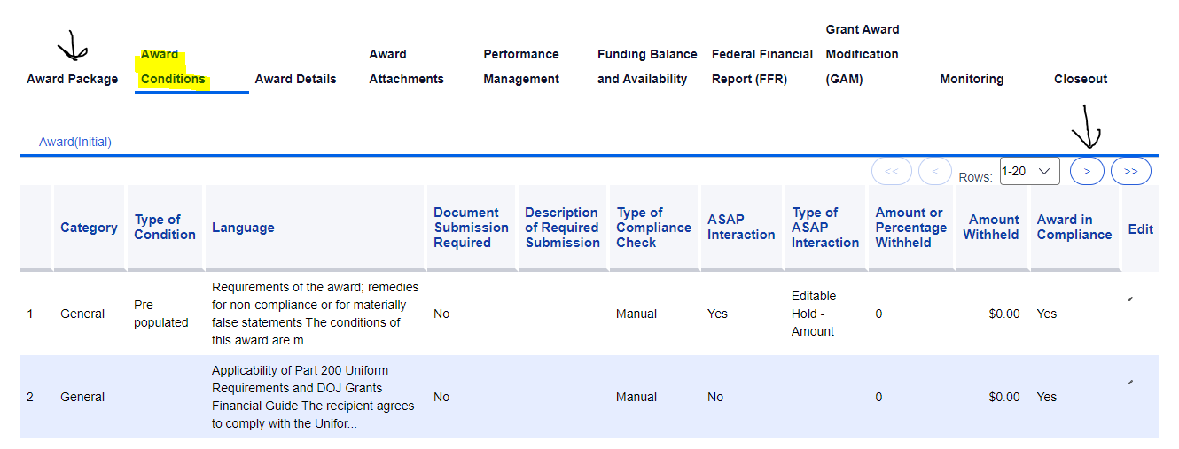
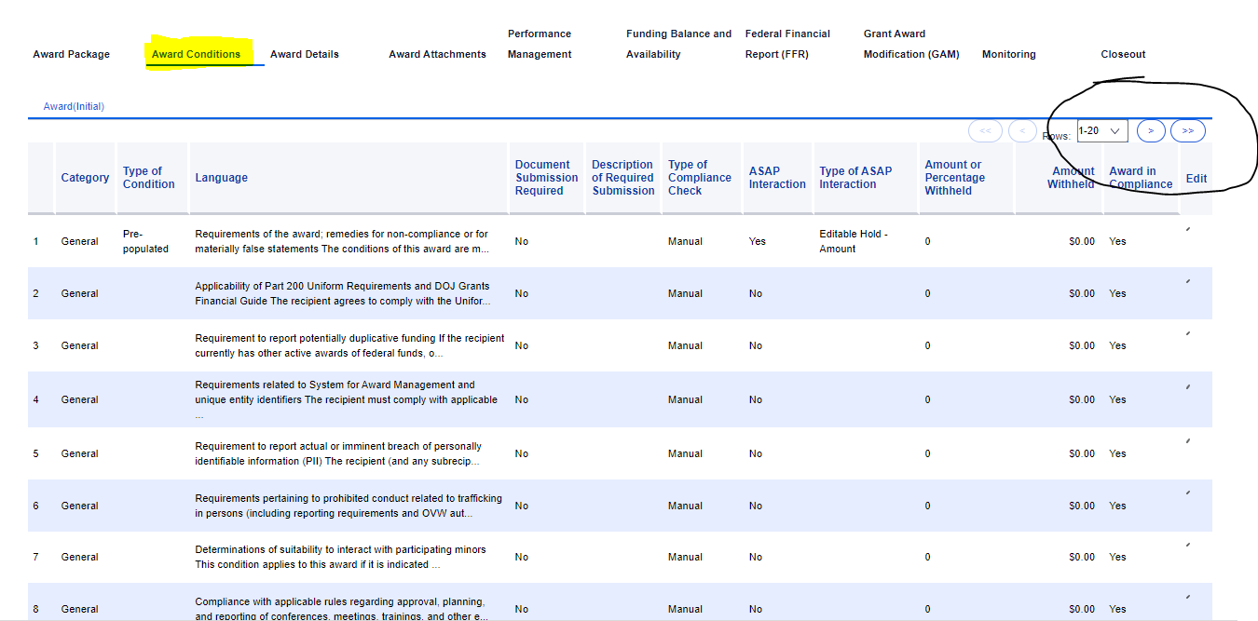
Award Conditions

Slide 17
Other Award Conditions
#46
#47
#48
Submitting policies during the planning phase
Reviewing and approving pre-existing curricula or training guides
Maintaining contact information in JustGrants
*We’ve covered 5 of 56 conditions—please read through the rest!

Slide 18
CY Grant Administration Guide Activity
Every grantee is assigned a grant management specialist based on states and territory assignments.
  Which grant manager is assigned to the state of North Carolina?
  What about the state of Utah?
  What about the state of Massachusetts?
Every grantee has access to the Technical Assistance (TA) providers.
  Raise your hand if you can name the Primary CYEM TA Provider.

Slide 19
OVW Tips
Read the award package, including the award conditions.
Find time to meet your grant manager while here.
Respond promptly to requests for budget revisions.
When in doubt, ask your grant manager.
Remember to…

Slide 20
CY Purpose Areas & OVW Priority Areas

Slide 21
CY Purpose Areas
Purpose 1
Purpose Area 1 – Children Exposed to Violence and Abuse (ages 0-10)
Purpose 2
Purpose Area 2 – Creating Safer Communities for Youth: Prevention, Intervention, Treatment, and Response to Youth (ages 11-24)
Purpose 3
Purpose Area 3 – School based Prevention, Intervention, and Response (ages 5-19)

Slide 22
Children Exposed to Violence and Abuse (ages 0-10)
Project activities must include, but are not limited to:
Direct services for children
Development of processes and provision of trainings for programs to identify children and/or families exposed to VAWA crimes
Training for law enforcement, courts, and other allied professionals to identify and respond to children exposed to violence
Development and implementation of prevention programming for children
Providing support services for non-offending caregivers
Notes:
Children and Youth grantees may address only one of the three purpose areas we have just reviewed. This year we have 5 grantees addressing purpose area 1, 6 addressing purpose area 2, and 5 addressing purpose area 3.
Purpose Area 1 – Children Exposed to Violence. Under this purpose area, grantees must work with children within the age group of 0-10 that have been the victim of or exposed to domestic violence, dating violence, sexual assault, and/or stalking.
*Can serve victims outside of this age group if siblings – we want to provide comprehensive services that work with everyone impacted. However, there is a cut off at age 24. We cannot serve anyone beyond age 24.
The first, and most important for this program, is the provision of direct services for children and youth. This includes mental health counseling, access to medical care (for example a sexual assault medical forensic examination), victim advocacy, court accompaniment, etc.
Second is training for law enforcement and other allied professionals. The training should focus on identifying, engaging, and/or responding to children and youth who have been impacted by or are victims of domestic violence, dating violence, sexual assault, and/or stalking.
And last, prevention programming for children and youth.
As I’ve mentioned before, it’s critical that these activities are developed and implemented for the specific ages and developmental stages that you will be serving through your grant. For example, say your organization is providing a training to law enforcement on domestic violence. For this program, the training should focus on how to identify and support children or youth that may be in the home or impacted by the violence. It’s not enough to do a training for law enforcement on what is domestic violence. You have to go deeper into what law enforcement can do if there are children present or if the victim says they have children. The training must be focused on meeting the needs and addressing the safety of the children and youth impacted by the violence.
There are additional requirements that are specific to each purpose area. We are not going to go over those in detail today due to the amount of time we have. I encourage you to refer back to the children and youth solicitation for clarity. If you have questions specifically about your purpose area, please feel free to reach out to me.

Slide 23
Creating Safer Communities for Youth (ages 11 – 24)
Project activities must include, but are not limited to:
Providing direct services for youth victims of VAWA crimes
Development and delivery of educational programming to respond to youth victims
Training law enforcement, courts, and other allied professionals to meet the needs of youth victims
Developing prevention programming for youth
Notes:
Purpose Area 2 is a bit more broad and is focused on addressing youth and young adults in the community that have been victims of or impacted by domestic violence, dating violence, sexual assault, and/or stalking. Projects must address the issue from a broad context to include prevention, intervention, treatment, and response services. This purpose area focuses on the age group of 11-24.
Must address from a broad perspective: intervention, prevention, treatment and response.
Not all of you will be addressing the full age range and that is ok. Focus on what your project does.

Slide 24
School-based (ages 5 – 19)
Project activities must include, but are not limited to:
Providing victim services and advocacy for students
Development and implementation of school-based policies, practices, and programs to prevent and respond to VAWA crimes
Training law enforcement, courts, school resource officers, teachers and faculty, coaches, parents, and other allied professionals to meet the needs of student victims
Implementation of prevention programming for students including bystander intervention training for students
Implementation of programs designed to change attitudes and behaviors focused on teen dating violence
Notes:
Purpose Area 3 is focused on working with schools and/or school systems to develop or enhance school policies and practices to address dating violence, sexual assault, and/or stalking involving students. Projects addressing this purpose area may serve children and youth ages 5 to 19.
Again, not everyone will be addressing the full age range. Some of you are only working with elementary schools, middle and high school.
Make sure, however, that you are working with the schools in the development of those policies bc that is a critical requirement of this purpose area.

Slide 25
OVW Priority Areas
Advance equity and tribal sovereignty as essential components of ending sexual assault, domestic violence, dating violence, and stalking by improving outreach, services, civil and criminal justice responses, prevention, and support for survivors from historically marginalized and underserved communities, particularly those facing disproportionate rates or impacts of violence and multiple barriers to services, justice, and safety.
Expand economic justice and financial advocacy for survivors of sexual assault, domestic violence, dating violence, and stalking, including as a tool for violence prevention.
Prevention of technology-facilitated abuse.

Slide 26
Attend OVW-sponsored trainings
Create or expand CCRs
Provide crisis intervention at all events
Participate in planning phase
Ensure activities are audience specific
Develop activities targeted to specific age groups
Engage community partners in project
Program Requirements
Notes:
Each of the purpose areas for the two different projects (Children and Youth AND Engaging Men) have specific requirements, which I’ll review in just a second. But before I do, I want to go over a few of the requirements that cross-over each type of project and purpose area.
The first is that you are required to participate in the TA events that are specific to the CYEM program. Until it is safe for us to be together again, these events will take place virtually. We’ll review these more in depth during the TA webinar that is scheduled for tomorrow.
Next, all grantees must create and/or expand a coordinated community response team. This team will, at a minimum include your project partners, and may include other programs, organizations, and/or individuals in your community that engage with and/or serve children and youth or boys and men (depending on what type of project you are implementing).
Every grantee is required to provide an individual trained in crisis intervention at all events not specifically targeted to first responders or allied professionals. This includes events such as training mentors, working with teachers, prevention education sessions with children and youth, and community outreach or awareness activities. This person must be in addition to the facilitator or presenter. The purpose of this is that this program is working with vulnerable individuals and if they are triggered during an event or activity, we want to be sure they are able to receive immediate care. This can only be done if the person responsible for crisis intervention is not facilitating the activity, otherwise the person in crisis must wait until the end of the event, which sometimes the person may leave and never receive the help they need. The person providing the crisis intervention should be able to ground the individual experiencing the trauma, assess for safety concerns and conduct safety planning if necessary, and make referrals for more in-depth counseling or other services.
Folks usually ask what the requirements are for the crisis intervention and our response is always that we rely on you and your expertise on what is necessary. You likely already have a policy in place regarding requirements but if not, this is a good opportunity to develop it. Please note that access to or using a 24 hour crisis hotline will not qualify as meeting this requirement. We want someone who is on site and available to meet that person who is in crisis and help ground them in that moment. This includes making sure they are safe, supported and have access to resources. We are aware of the particular vulnerabilities of this specific population and want to make sure we are providing the appropriate, trauma informed approach to help them in that moment.
And last, every grantee has a planning phase as part of their project. We’ll go over this more in depth in just a few moments.
Next, I want to spend a few moments on some important aspects of the two projects and the purpose areas. First is that the project activities, including any products to be developed, must be specific to the age, developmental stage, and/or audience for which it is addressing. This is especially important for those grantees who will be working with a large range of ages. For example, purpose area 2 can address youth and young adults ages 11 to 24. Now we all know working with someone age 24 is very different than working with someone who is age 11. This is why it is so important to make sure you have the right individuals with the education, expertise, skill, and knowledge necessary to effectively engage with the age group being served by your project. The most successful projects I’ve seen since managing this program are those programs that target a specific age range within the age group of the purpose area their project is addressing. For example, purpose area 3 can address children, youth, and young adults ages 5 to 19. Like the previous example, working with a student age 19 is very different than working with a student that is 5 years old. So, in this example, a grantee would have a greater impact if the project focused on children ages 5-10 or youth ages 11-13 instead of trying to do it all.
(I’m confused why we’d be talking about focusing on certain ages to be successful when they already wrote their project narratives indicating which groups they would be focused on. This seems more applicable to the pre-webinar).
Next, let’s talk a bit about project partners. For the CYEM program, it is expected that you will regularly engage with your project partners throughout the project. Project partners are integral to the sustainability of the project beyond the life of the award. We strongly encourage cross-training between project partners as well. For example, the training should not just be from the grantee to the partners. While it’s important for partners to understand the VAWA crimes, it’s also important for the grantees to understand the work of the project partners. Educators are skilled at teaching and understanding childhood development, fatherhood programs are skilled at working with men, faith-based leaders are skilled at working with individuals with strong religious beliefs, youth serving organizations are skilled at understanding youth and their needs, and etc. We all have something to learn from each other and collectively that makes our work more impactful. So, please work closely with your partners and include them as much as possible not only in the planning phase, but in all project activities throughout the award. Your projects will be stronger for it.

Slide 27
Unallowable Activities
Research Projects
Child Protective Service Investigations
Child Visitation Services
Perpetrator Services
Regional or State-wide activities
TA Provision
Trademarks
Notes:
Next we’re going to briefly discuss the unallowable activities under the CYEM program.
Grant funds may not be used to support:
Child protective service investigations of abuse and neglect
Child visitation activities, services, or fees including supervised visitation
Athletics – grant funds cannot support fulltime salaries for coaches, transportation for teams to practice or games, purchase of equipment, etc. Grant funds may be used to compensate a coach for a percentage of his/her salary for time spent being trained and /or providing training. Examples: use of a bus to transport to a game but could use a bus to transport to a training on VAWA.
Ceremonies or award events. Comes up a lot, particularly with children and youth as it is a really important thing for them. However, these activities aren’t supported. So awards, certificates, celebration meals, etc.
Regional or state-wide activities. All project activities must be community based.
Developing or disseminating training, products, or policies on sexual harassment, hazing and/or bullying, gender norms, or substance abuse. Project activities must focus on the VAWA crimes of domestic violence, dating violence, sexual assault, and/or stalking. Of course there is some intersection between these. Grantees may address the intersections, but cannot focus solely on these topics.
TA – the provision of assistance to other organizations in implementing their projects. This is different than providing training, including cross-training to other orgs, partners, ccr members, community members. Schools, etc.

Slide 28
Unallowable Activities Cont.
Training, products, or policies focused on:
  Sexual Harassment
  Hazing and/or bullying
  Substance abuse prevention
Ceremonies and Award Events
Athletics
General violence prevention
Notes:
grant funds may not be used to provide services to perpetrators. Since grant funds are governed by VAWA, funds cannot be used to support perpetrators such as counseling, advocacy, or other victim focused services or court ordered batterer-intervention programming. You may engage with them in a manner to prevent future victimization so it is from a prevention lens. Intervention strategies or services are not allowed. But if they have done the work outside of the program and are now coming in for prevention work or to be a role model then that is allowed.
Grants funds may not be used to address youth violence, such as gang involvement, gun violence, or physical violence, unless there is a clear and identifiable link to the VAWA crimes of domestic violence, dating violence, sexual assault, and/or stalking.
Grant funds cannot support theatre performances that do not focus on the VAWA crimes.

Slide 29
Things That Are Allowable
Serve child and youth survivors
Provide food to children, youth and adult survivors
Provide support and services to non-offending caregivers when serving a child
Provide services to a sibling whose age falls outside the project purpose area
Notes:
Now that we’ve addressed some of the things you can’t do, let’s talk about what you can do!
Under this program, depending on which type of project you are implementing, Children and Youth or Engaging Men, grantees may provide services for children and youth survivors that identify as male.
Grantees may engage with juveniles and adults in detention or correctional facilities. (If there is time, expand upon this.)
Food is allowable under limited circumstances with prior approval from your OVW program specialist. Ex: doing an after school activity with youth, some youth don’t have access to food at home and we don’t want them to go hungry so we will allow food for the youth. Food is never allowed for adults. Must get approval in the event you’re audited, you want to show you had approval.
And grantees may provide support and services to non-offending caregivers. This is especially important for those CY grantees implementing purpose area 1, working with the little kiddos ages 0-10. Also, for the older children and youth, it is important for non-offending caregivers to have information on how to support their child if they are victimized. We want to make sure the person is getting the help and support they need if they are victims and/or have the resources to support the youth who have been victims or who have been exposed. A lot of times, adults don’t have that support base or knowledge to help the youth they are caring for.

Slide 30
OVW Tips
Create a work plan that can be shared with staff, particularly new staff not familiar with the project
Work in partnership with your project partner(s)
Reach out to the Thrive TA team and your OVW grant manager when you need help with your project
thriveta@caminarlatino.org

Slide 31
Grant Administration

Slide 32
DOJ Justice Grant System (JustGrants)
DOJ wide system used to apply for and manage DOJ awards
Every grant administrative procedure is conducted in JustGrants
  Application submission; award acceptance
  Budget approval
  Submission of deliverables and GAMs
  Submission of performance and financial reports
  Entity role management

Slide 33
Managing Roles in JustGrants
Six possible roles:
  Entity Administrator
  Grant Award Administrator
  Alternate Grant Award Administrator
  Application Submitter
  Authorized Representative
  Financial Manager

Slide 34
Administrative Duties
Grant project oversight to ensure timely completion of activities
Collect and report on grant activities and financial status
Participate in monitoring visits from OVW if requested
Submit all deliverables and GAMs in JustGrants
Maintain up-to-date roles in JustGrants

Slide 35
Communication with OVW
Conducted informally through email and formally in JustGrants
Award Condition 48 – maintaining contact information in JustGrants
OVW will only correspond about the project with people listed in roles in JustGrants
Develop a communication sharing plan for staff, grant manager, TA providers

Slide 36
OVW Tips
Familiarize yourself with JustGrants
Add different people to the roles so not one person has the login information
Keep information up to date
Develop a communication plan

Slide 37
Performance and Financial Reporting
Performance Reports
Financial Reports
Due Semi-Annually (Jan & Jul)
Due by the 30th day (even if 31 days in the month)
Report activities undertaken during the reporting period
VAWA MEI provides TA to grantees
Due Quarterly (Jan, Apr, Jul, Oct)
Due by the 30th day (even if 31 days in the month)
Report the draw down status during the reporting period
Refer to OVW grant management
Notes:
Session by PARE this afternoon.

Slide 38
Submission of Deliverables and Products
Work plan and policies
Questionnaires, focus group questions
Posters, flyers, brochures, newsletters, promotional items
Training materials – PowerPoint slides, handouts, curricula (even if purchased – see also Costs GAM for this)
Notes:
The special conditions on the award require grantees to submit all products developed and/or used with grant funds such as brochures, training materials, curricula, power point presentations, PSAs, websites, manuals, wallet cards, and posters to OVW for approval prior to using them. These items should be submitted to OVW at a minimum of 20 business days prior to your needing to use them to allow sufficient time for OVW to review and approve them. However, depending on the length and volume of the documents, and any possible revisions (which there are almost always revisions), it may take much longer. We will discuss the process for submitting products in just a bit.
One question I always get is, “I’m using a product off-the-shelf, like Coaching Boys Into Men. Do I need to get approval?” The answer is yes. There is a special condition on the award that requires grantees to get approval from OVW prior to utilizing pre-existing curricula and/or training guides that will be used during the project. Even if there is a line item in your budget and your budget is approved, the special condition on the award requires additional approval from OVW.

Slide 39
Deliverables and Products, Cont.
Event agendas, presentations, handouts/flyers, promotional items
Campaigns – PSAs, social media campaigns, billboards
Videos, podcasts, transcripts from these
Web sites
Non-English translation of materials (must be previously approved in English)

Slide 40
How and When to Submit
Upload and submit in JustGrants as Project Deliverable.
Include notes in the text box or as a separate document explaining how the materials will be used.
  Include notes if there are sections that will not be used.
Submit as early as possible, but at least 20 business days prior to when the product will be used or the registration date for the training request.
Notes:
Everything is done in JustGrants. You’ll submit as either a GAM or a Project Deliverable. Include age, audience, purpose of deliverable.
Once approved you will receive an email notifying you (GAA) that it has been approved and you may begin using it, implementing it, etc.
For non-OVW CYEM training/conferences, there is a form that must be filled out and submitted with the request. We will go over how to access that form in a future session.

Slide 41
OVW Disclaimer Required
The OVW disclaimer must be on all materials, including items created by project partners for the project.
All written materials such as flyers, posters, training curriculums
All web-based materials such as websites
Public service announcements, inclusive of audio and/or video
Promotional materials such as billboards, print advertisements
Training materials, such as handouts and agendas
Social media posts (photos, ads)
Notes:
The OVW disclaimer must be on all materials. This is another special condition on the award. Basically, if you are submitting a product or deliverable for OVW review and approval, the OVW disclaimer should be included. The only exception is for certain items that are too small for the disclaimer, such as tshirts, buttons, pens, bracelets. When in doubt, include the disclaimer!

Slide 42
OVW Disclaimer
This project was supported by
Grant No. __________________ awarded by the Office on Violence Against Women, U.S. Department of Justice. The opinions, findings, conclusions, and recommendations expressed in this publication/program/exhibition are those of the author(s) and do not necessarily reflect the views of the U.S. Department of Justice.
Notes:
The disclaimer is listed in the special conditions in you’re award documents. The disclaimer should be used as it is written and not modified in any way.
The number one reason why a product is change requested back to the grantee is not including the OVW disclaimer. Please get int the habit of including the disclaimer on everything you submit.

Slide 43
Grant Award Modifications (GAMS)
Project Period Extension
Programmatic
Cost
Scope Change
Financial
Budget Modification
Project Period Change
Notes:
We’re almost to the end! Next we’re going to talk about Grant Award Modifications, or GAMs for short. Changes to the project will be made in JustGrants under GAMs section.
GAMs are to modify a key fact or detail about the award.
There are three types of GAMs:
Project Period Extension
Programmatic, which has two subsets: - a) cost and b) scope change. Cost is for prior approval of consultant rates or sole source and training requests or requests to attend non-OVW CYEM TA events.
Financial – for budget modifications
If you have any questions, please just shoot me an email or access the training that is available on JustGrants.

Slide 44
Types of Programmatic GAMs
Costs
Scope Change
Prior approval to attend non-OVW sponsored events such as trainings
Allocation of funds < 10% of the total budget
Purchase of food for survivors and youth
Bring in outside presenters or consultants
Changes in scope of project
Changes in deliverables
Changes in key personnel or MOU partners

Slide 45
Types of Budget GAMs
There are two types of changes related to the budget
Budget Revision (less than 10% of the award)
Budget Modification (10% or more of the award)
Notes:
There are two types of changes related to the budget. A budget revision and budget modification. It is a bit time consuming to go over this process today so we will save this for another day. Besides, budgets have not been approved yet, so any changes related to the budget will be done as part of the budget approval process for now.

Slide 46
CY Administrative Guide Activity
Performance Reporting – when is your first performance report due?
  Normally it would be January 30. However, this year it is pushed to March due to the new reporting form. More info from the Policy, Assessment, Research and Evaluation (PARE) unit this afternoon!
Who can find and read out loud the OVW disclaimer?
Who do you email if you are having issues with JustGrants? (bonus points if you can find the email)
  OVW JustGrants Support OVW.JustGrantsSupport@usdoj.gov

Slide 47
OVW Tips
Ask for help!
Grant Administration = OVW
Project Assistance = OVW or TA
Support:
OVW JustGrants Support
866-655-4482 OVW.JustGrantsSupport@usdoj.gov
OVW Grants Financial Management Division 888-514-8556 OVW.GFMD@usdoj.gov
Muskie School of Public Service
800-922-VAWA (8292) vawamei@maine.edu

Slide 48


Contact Information
Become an OVW peer reviewer:
www.justice.gov/ovw/peer-review
Check us out on social media:
Twitter: @OVWJustice
Linkedin: linkedin.com/company/office-on-violence-against-women-ovw/
Learn more about our grants at:
www.justice.gov/ovw/grant-programs
Elaina Roberts Elaina.Roberts@usdoj.gov
Derek O’Leary Derek.O’Leary@usdoj.gov
Traci Rollins-Johnson Traci.Rollins@usdoj.gov
Anne Hamilton Anne.Hamilton2@usdoj.gov
OVW.ChildrenYouth@usdoj.gov

